Slide 1
Buoyancy

Slide 2
Buoyancy
Whenever a body is immersed wholly or partially in a fluid; it is subjected to an upward force which tends to lift (or buoy) it up.
This tendency for an immersed body to be lifted up in the fluid is due to an upward force opposite to action of gravity is known as buoyancy.
The magnitude of the buoyant force can be determined by Archimedes principle which states as follows:
"The buoyant force acting on a body immersed in a fluid is equal to the weight of the fluid displaced by the body, and it acts upward through the centroid of the displaced volume."

Slide 3
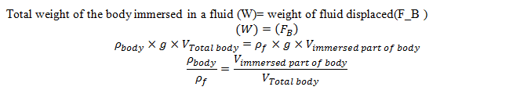
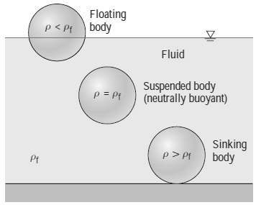
For floating bodies, the weight of the entire body must be equal to the buoyant force, which is the weight of the fluid whose volume is equal to the volume of the submerged portion of the floating body. That is
It follows from these discussions that: a body immersed in a fluid

Slide 4
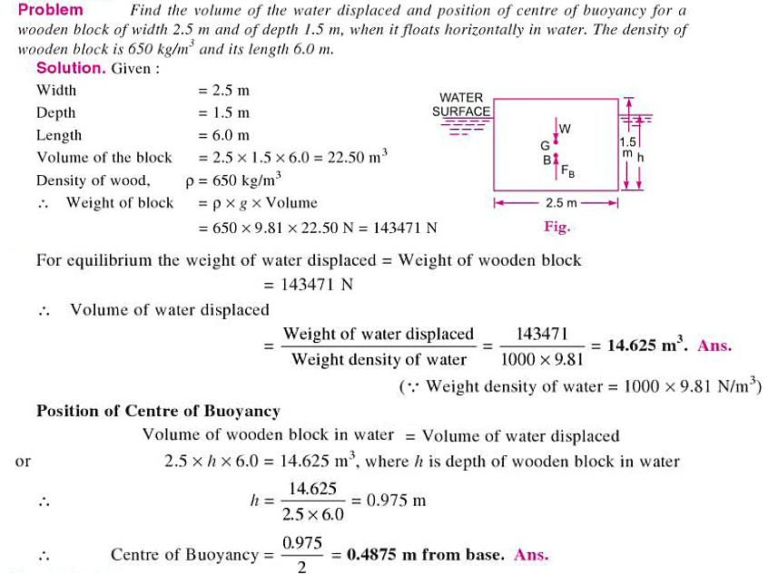
Centre of Buoyancy
It is always the centre of gravity of the volume of fluid displaced.

